Slide 1
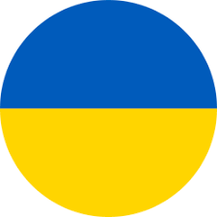
Current Target Risk Countries of Origin
Portugal
Ukraine
Moldova
Kazakhstan
10th August 2020

